Slide 1
Chapter 9: The Celebration of Confirmation
Day 4: Confirmation calls those anointed to live out their Baptism as witnesses of Jesus Christ.

Slide 2
are love, joy, peace, patience, kindness, generosity, faithfulness, gentleness, and self-control.
The fruits of the Holy Spirit

Slide 3
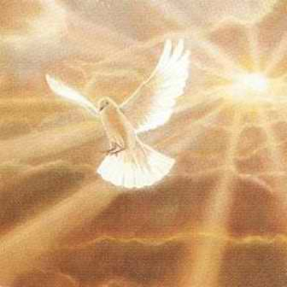
The Holy Spirit strengthens us to share and to be his
the mission of Jesus
witness to others.

Slide 4
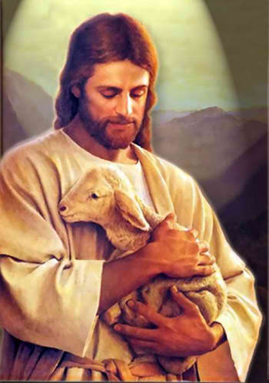
What are some ways we can continue Jesus’ work and be his witnesses?:
show kindness to the poor
welcome strangers
share our Catholic faith with others
stand up against injustice and hatred
work for a better community and world.

