Slide 1
Chapter 9: The Celebration of Confirmation
Day 3: The gifts of the Holy Spirit help those who are confirmed.

Slide 2
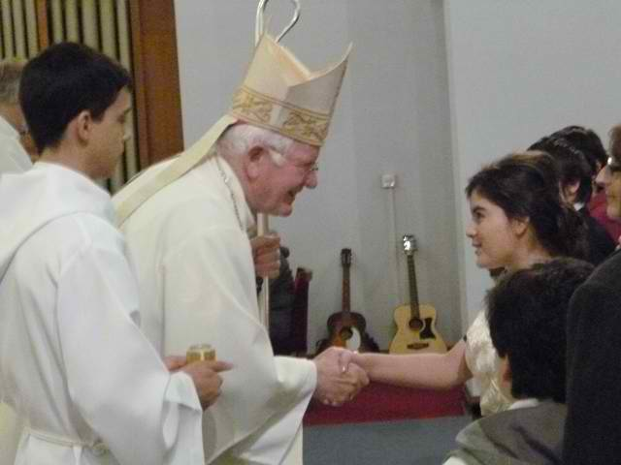
When the candidates are anointed with the laying on of hands, they are marked as people who share fully in
The gifts of the Holy Spirit help us to live as faithful followers of Jesus Christ because they
Jesus’ mission.
strengthen us to do what Christ asks of us.

Slide 3
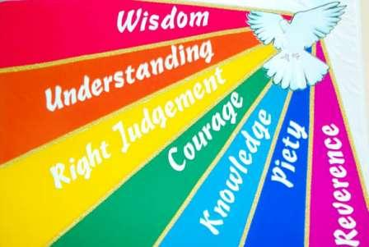
are wisdom, understanding, right judgment, courage, knowledge, reverence, and wonder and awe.
The gift of makes it possible for us to love and respect all that God has created.
The Gifts of the Holy Spirit
reverence

Slide 4
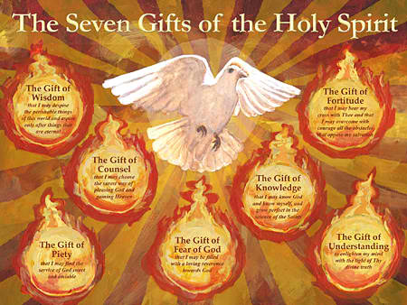
The gift of helps us to see God’s presence and love filling all creation.
The gift of strengthens us to give witness to our faith in Christ.
The gift of aids us in making good choices.
wonder and awe
courage
right judgment

Slide 5
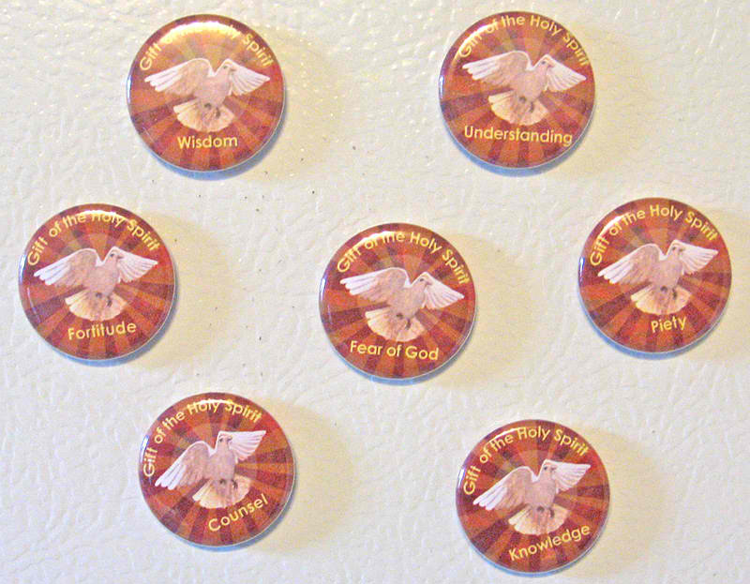
The gift of helps us to see and follow God’s will in our lives.
The gift of helps us to love others as Jesus calls us to do.
The gift of brings us to learn more about God and his plan, and leads us to wisdom and understanding.
wisdom
understanding
knowledge

