Slide 1
Chapter 9: The Celebration of Confirmation
Day 2: In the Sacrament of Confirmation, we are sealed with the Gift of the Holy Spirit.

Slide 2
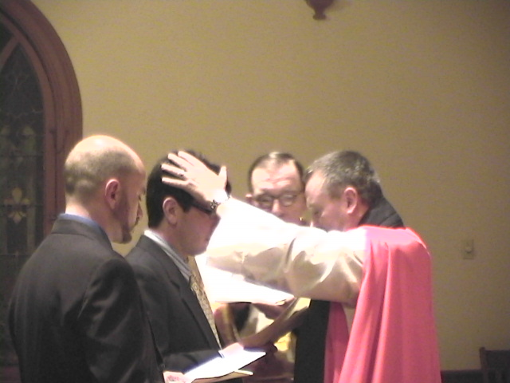
At Confirmation, the bishop invites everyone to pray for the outpouring of on those being confirmed.
the Holy Spirit

