Slide 1
Chapter 9: The Celebration of Confirmation
Day 1: Confirmation leads us from Baptism to the Eucharist.

Slide 2
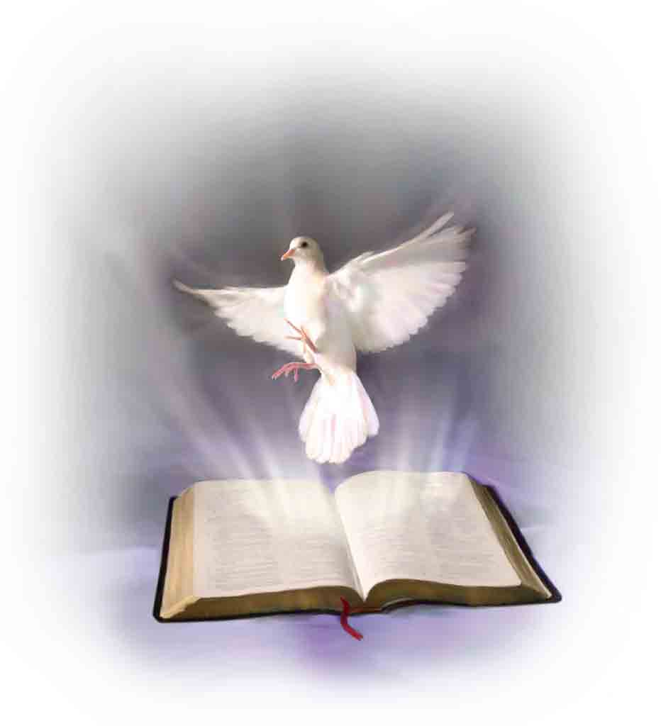
Confirmation leads us from Baptism to the Eucharist and full initiation in
is someone who intercedes on our behalf, speaks for us, or defends us. The Holy Spirit is our advocate.
the Church.
An advocate

Slide 3
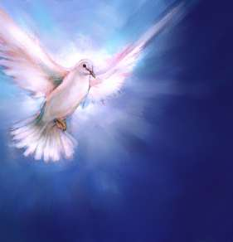
Titles of the Holy Spirit and their significance:
Advocate: the Holy Spirit can intercede for us.
Spirit of truth: the Holy Spirit guides us as we learn the truth of our faith.

Slide 4
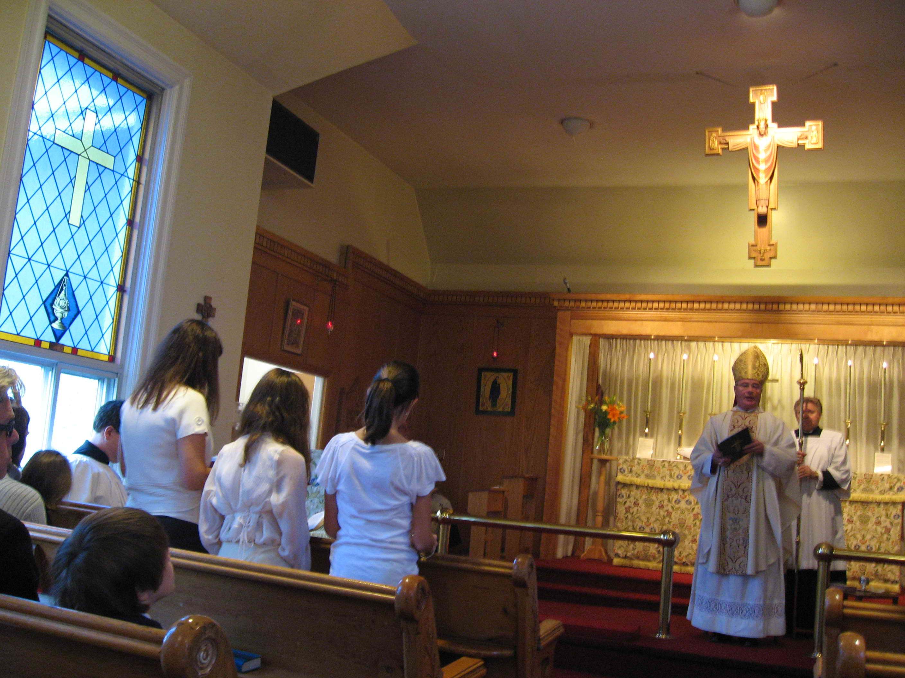
At Confirmation, candidates stand and renew their
In the celebration of Confirmation, we gather with our parish community and express our belief in
baptismal promises.
Jesus Christ.

Slide 5
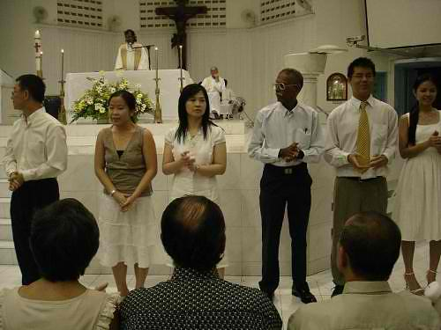
The sacrament of Confirmation is celebrated with
within the
the parish community
Mass.

